Slide 1
SEM3
Sample-Efficient, Multi-Modal Model
Noah Rousell, Adithya Sriram, Julian Beaudry, & Ryan Eng

Slide 2
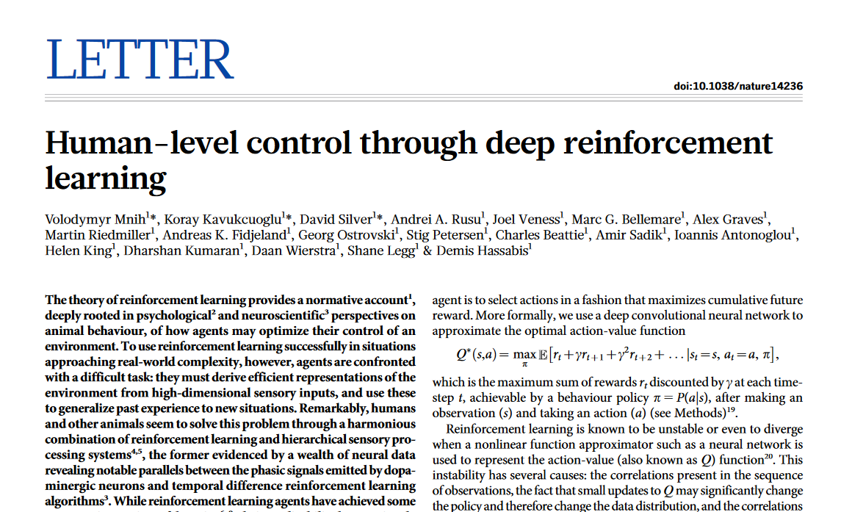
Deep Q Networks (DQN)
Comparable/Superhuman on the majority of Atari 2600 games
But:
Requires 38 days of data
Single modality
Mnih et al. 2015

Slide 3

Deep Q-Learning (DQN)
Train a neural network to estimate the Q value of each action
Store experience (state, action, reward) in replay buffer and sample in mini-batches when performing gradient descent
Where is a version of the network with “stale” parameters
This stabilizes training
Mnih et al. 2015

Slide 4
DQN Improvements

Slide 5
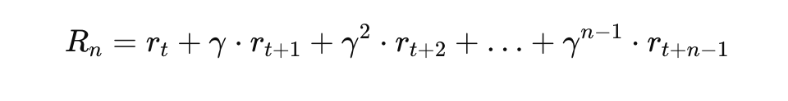
N-step learning
Idea: Look further ahead at ground-truth rewards to improve training

Slide 6

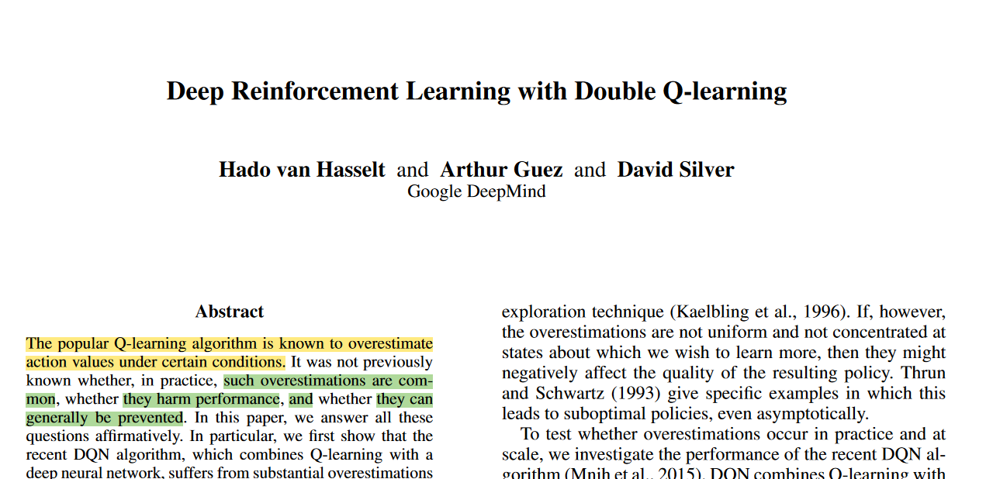
Double DQN
Hasselt et al. 2015
Idea: reduce over-estimation of Q-values by using the online network for action selection of the Q-learning target

Slide 7
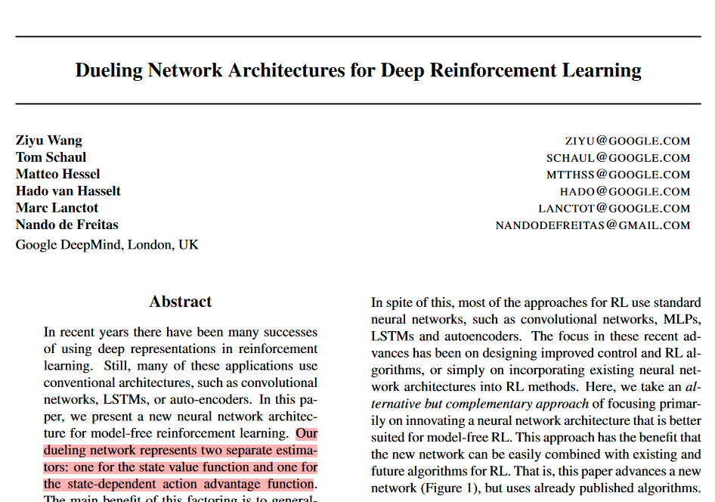
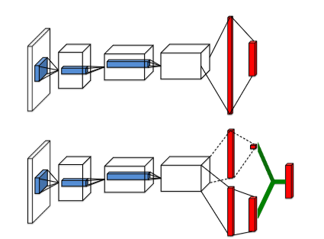
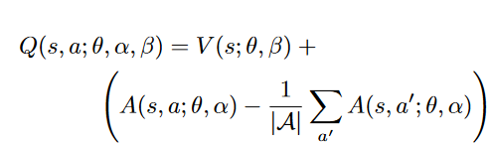
Dueling DQN
Wang et al. 2016
Regular Q-network
Dueling Q-network

Slide 8
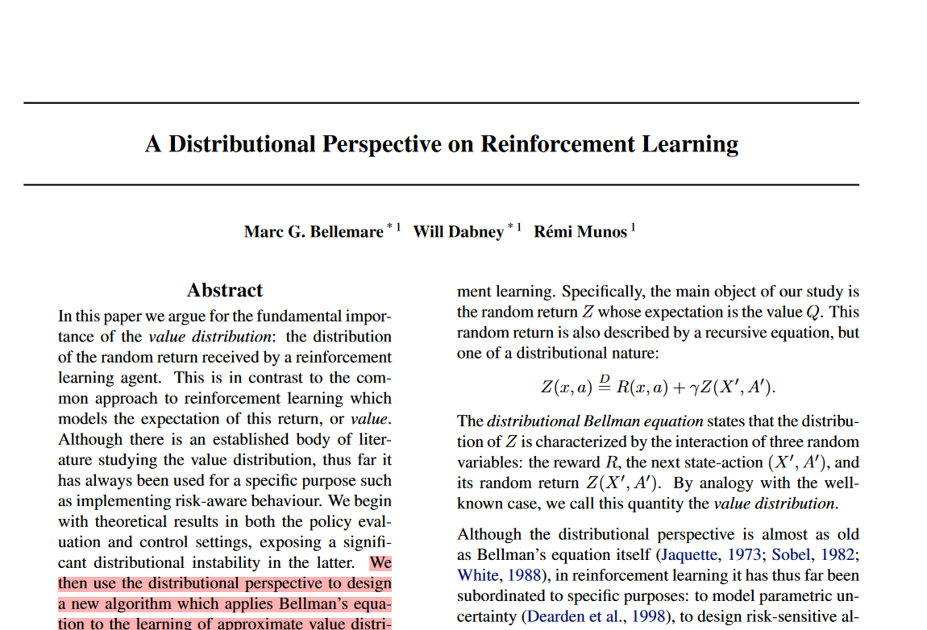
Distributional DQN
Bellemare et al. 2017
Idea: Approximate the distribution of each Q value instead of the expected value

Slide 9
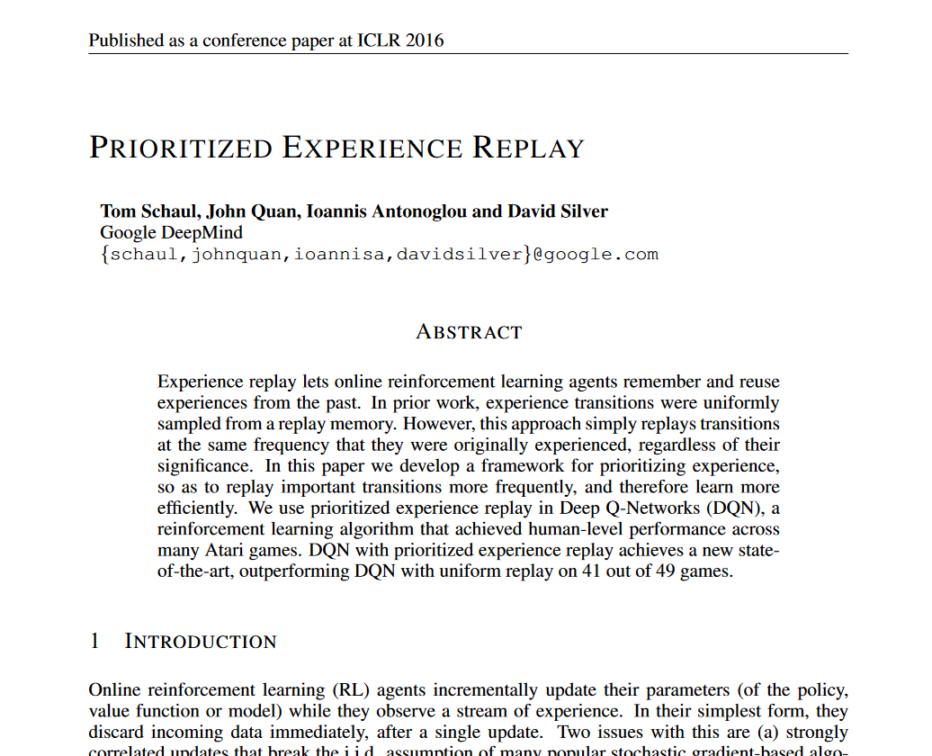
Prioritized Experience
Idea: Sample experiences from replay buffer in proportion to their corresponding RL loss
Schaul et al. 2016

Slide 10
But… 38 days?

Slide 11
Training Sample-Efficient Models is hard!
Reward signal is sparse
Re-using experiences from replay buffer leads to massive overfitting

Slide 12
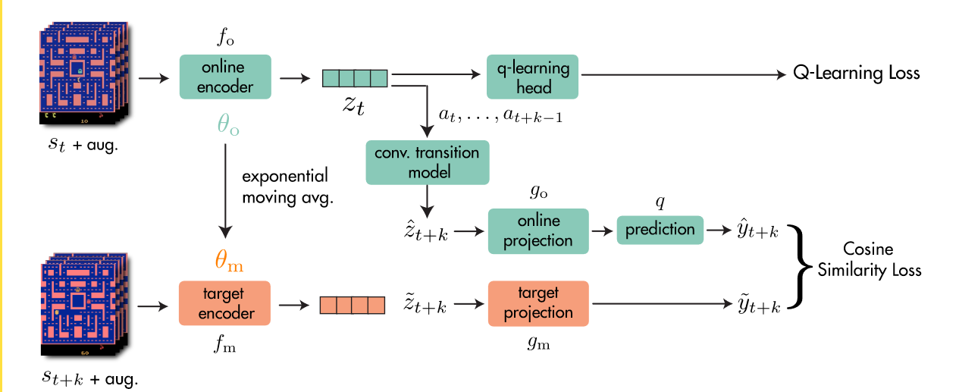

Self-Predictive Representations (SPR)
Data augmentation
Schwarzer et. al. 2021

Slide 13
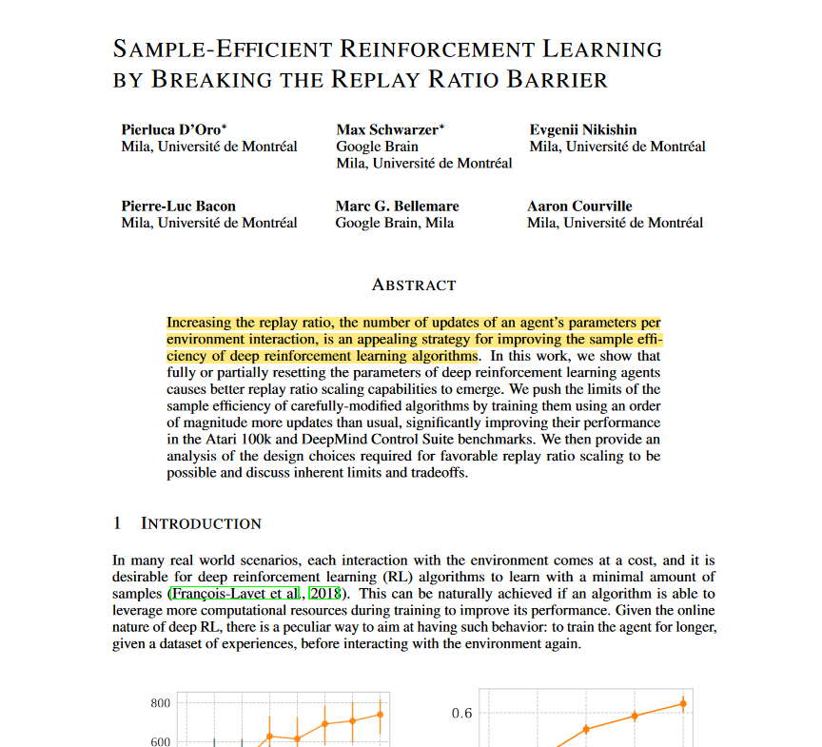
Making Experiences Go Farther
Idea: reset / partially-reset parameters periodically
Shrink-and-perturb: interpolate weights partway to random values (they move weights 20% to random)
D’Oro et al. 2023

Slide 14
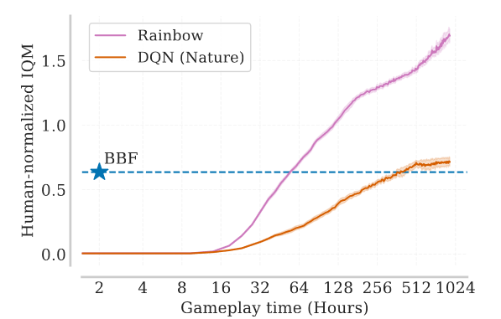
Bigger, Better, Faster (BBF)
Everything so far, with:
Wider/deeper network
Carefully-designed Regularization
Shrink-and-Perturb: interpolate 50% to random values
Weight decay
Exponential schedule for update horizon (n) and discount factor (γ)
Schwarzer et. al. 2023

Slide 15
Our Model

Slide 16

Audio Encoder
Schwarzer et. al. 2021

Slide 17
Results (!)
10k steps (~12 minutes)
25k steps (~25 minutes)

Slide 18
Questions?

Slide 19
Papers & Code
Bigger, Better, Faster 2023- Github
Self-Predictive Representations- Github
Threads
Audio
Cross-modal Attentive Skill Learner- Github
A Distributional Perspective on Reinforcement Learning
Dueling Network Architectures for Deep Reinforcement Learning- Github
Deep Reinforcement Learning with Double Q-learning

